Slide 1
Online Student Result System
SlideMake.com

Slide 2
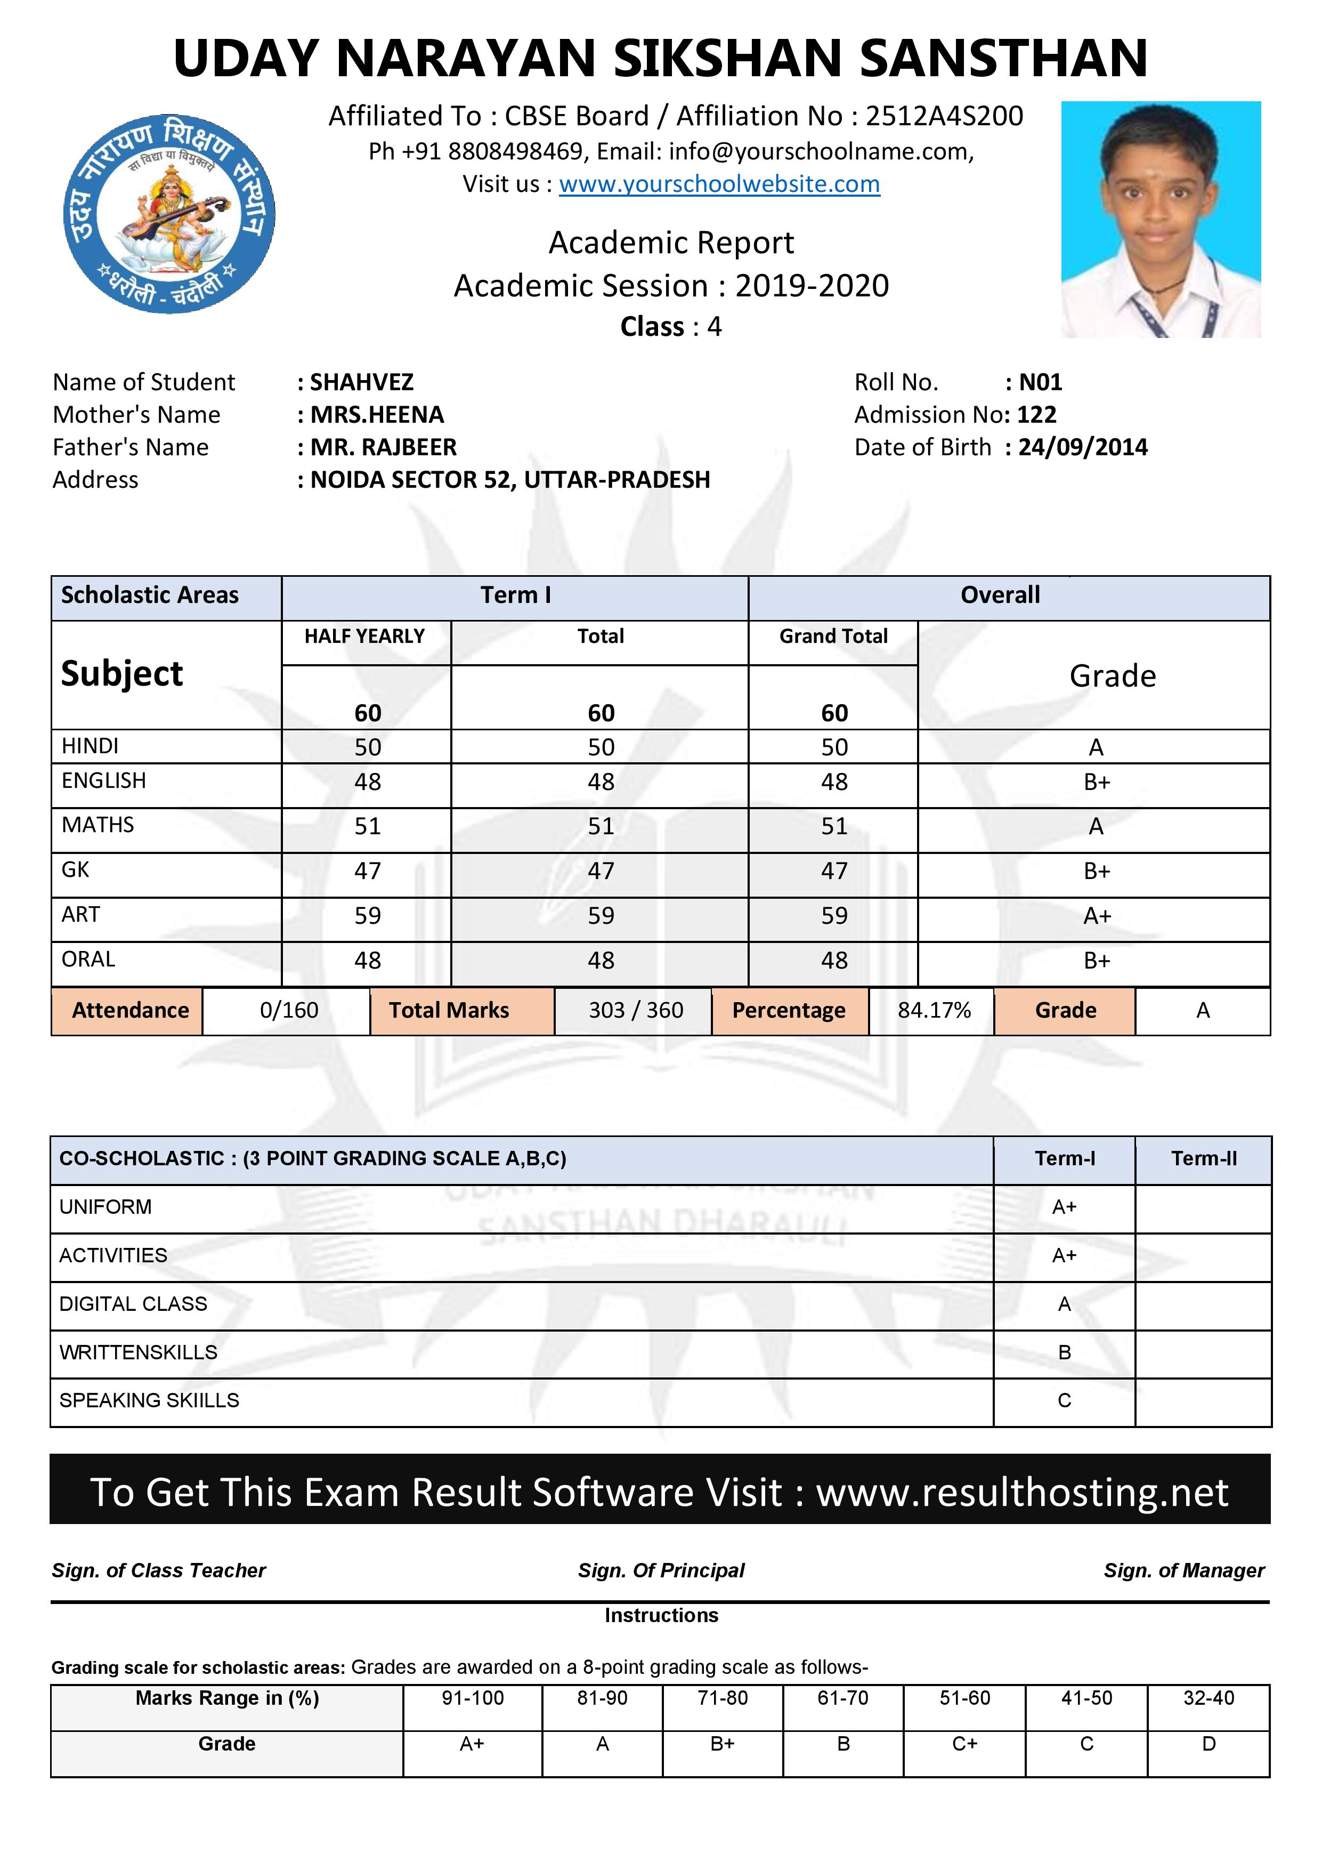
Introduction
Online student result system is a web-based platform designed to provide easy access to student grades and performance data.
The system includes separate interfaces for administrators and students to access and manage information efficiently.
Developed using PHP and MySQL, this system ensures secure and reliable data management.
Notes:
Image source: https://resulthosting.net/?attachment_id=77

Slide 3
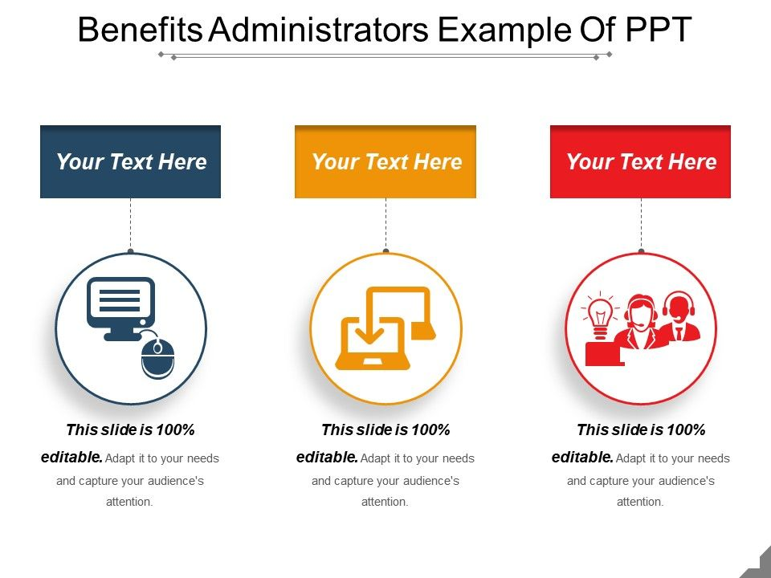
Benefits for Administrators
Administrators can easily input, update, and manage student grades and results in real-time.
The system allows for generating detailed reports and analytics to track student performance trends.
Automated notifications and alerts help administrators stay informed about important updates and deadlines.
Notes:
Image source: https://www.slideteam.net/benefits-administrators-example-of-ppt.html

Slide 4
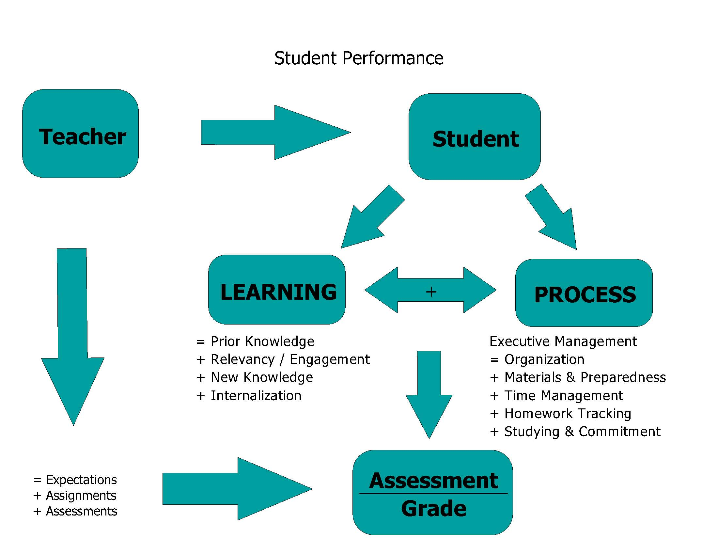
Benefits for Students
Students can access their grades, course schedules, and academic progress anytime, anywhere.
The system provides a user-friendly interface for students to view and analyze their performance data.
Personalized feedback and recommendations help students improve their academic performance.
Notes:
Image source: https://lessoncampusdebby.z22.web.core.windows.net/are-grades-an-accurate-representation-of-learning.html

Slide 5
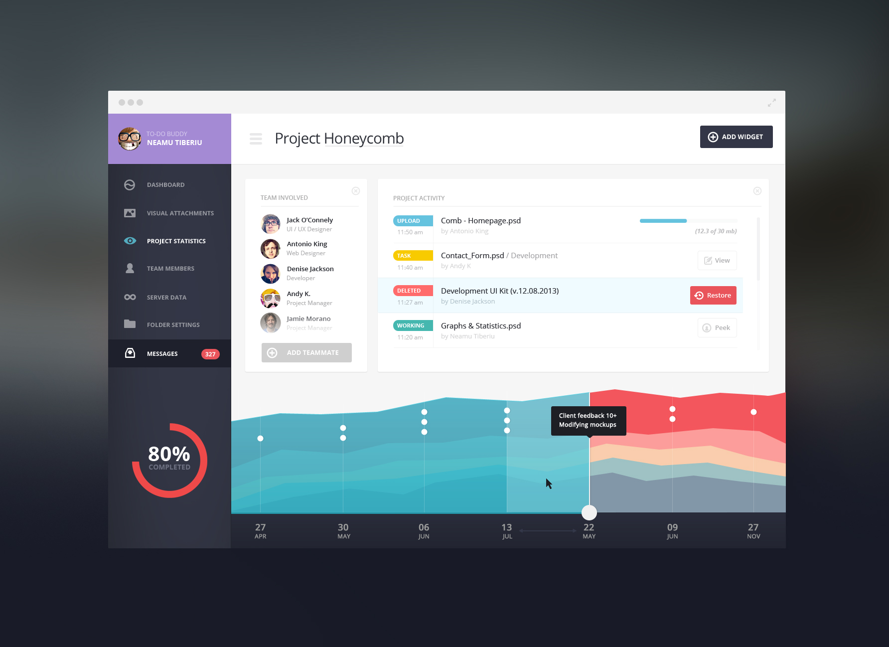
Features for Administrators
User-friendly dashboard for easy navigation and data entry.
Secure login system with role-based access control for administrators.
Advanced search and filter options to quickly retrieve student information.
Notes:
Image source: https://joshua.doodnauth.com/2014/03/design-inspiration-admin-dashboard-ui/

Slide 6
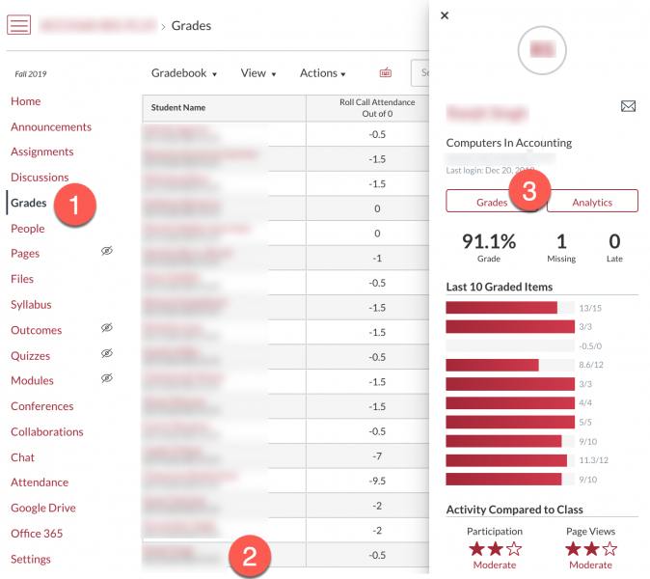
Features for Students
Individual student profiles displaying grades, attendance, and course history.
Interactive charts and graphs for visualizing academic progress.
Option to download and print official transcripts and certificates.
Notes:
Image source: https://www.csustan.edu/office-academic-technology/canvas-how-gradebook-setup-and-grading

Slide 7

System Architecture
The online student result system is built on a PHP backend connected to a MySQL database.
Front-end interfaces are designed using HTML, CSS, and JavaScript for a responsive user experience.
Integration of APIs for seamless communication between the database and the user interfaces.
Notes:
Image source: https://www.slidemake.com

Slide 8
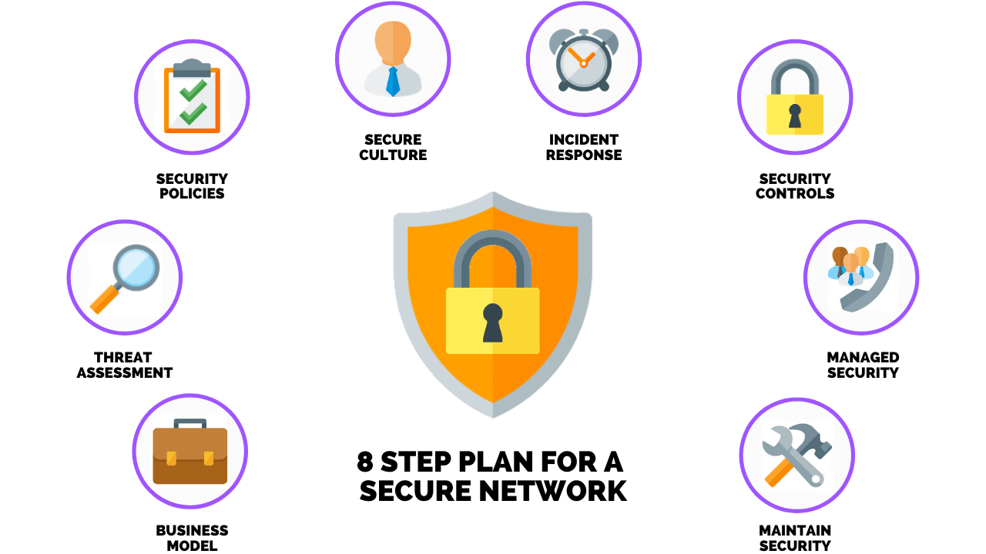
Data Security Measures
Implementation of encryption protocols to protect sensitive student data.
Regular data backups and disaster recovery plans to prevent data loss.
Compliance with data protection regulations to ensure privacy and confidentiality.
Notes:
Image source: https://ar.inspiredpencil.com/pictures-2023/cyber-security-planning-guide

Slide 9
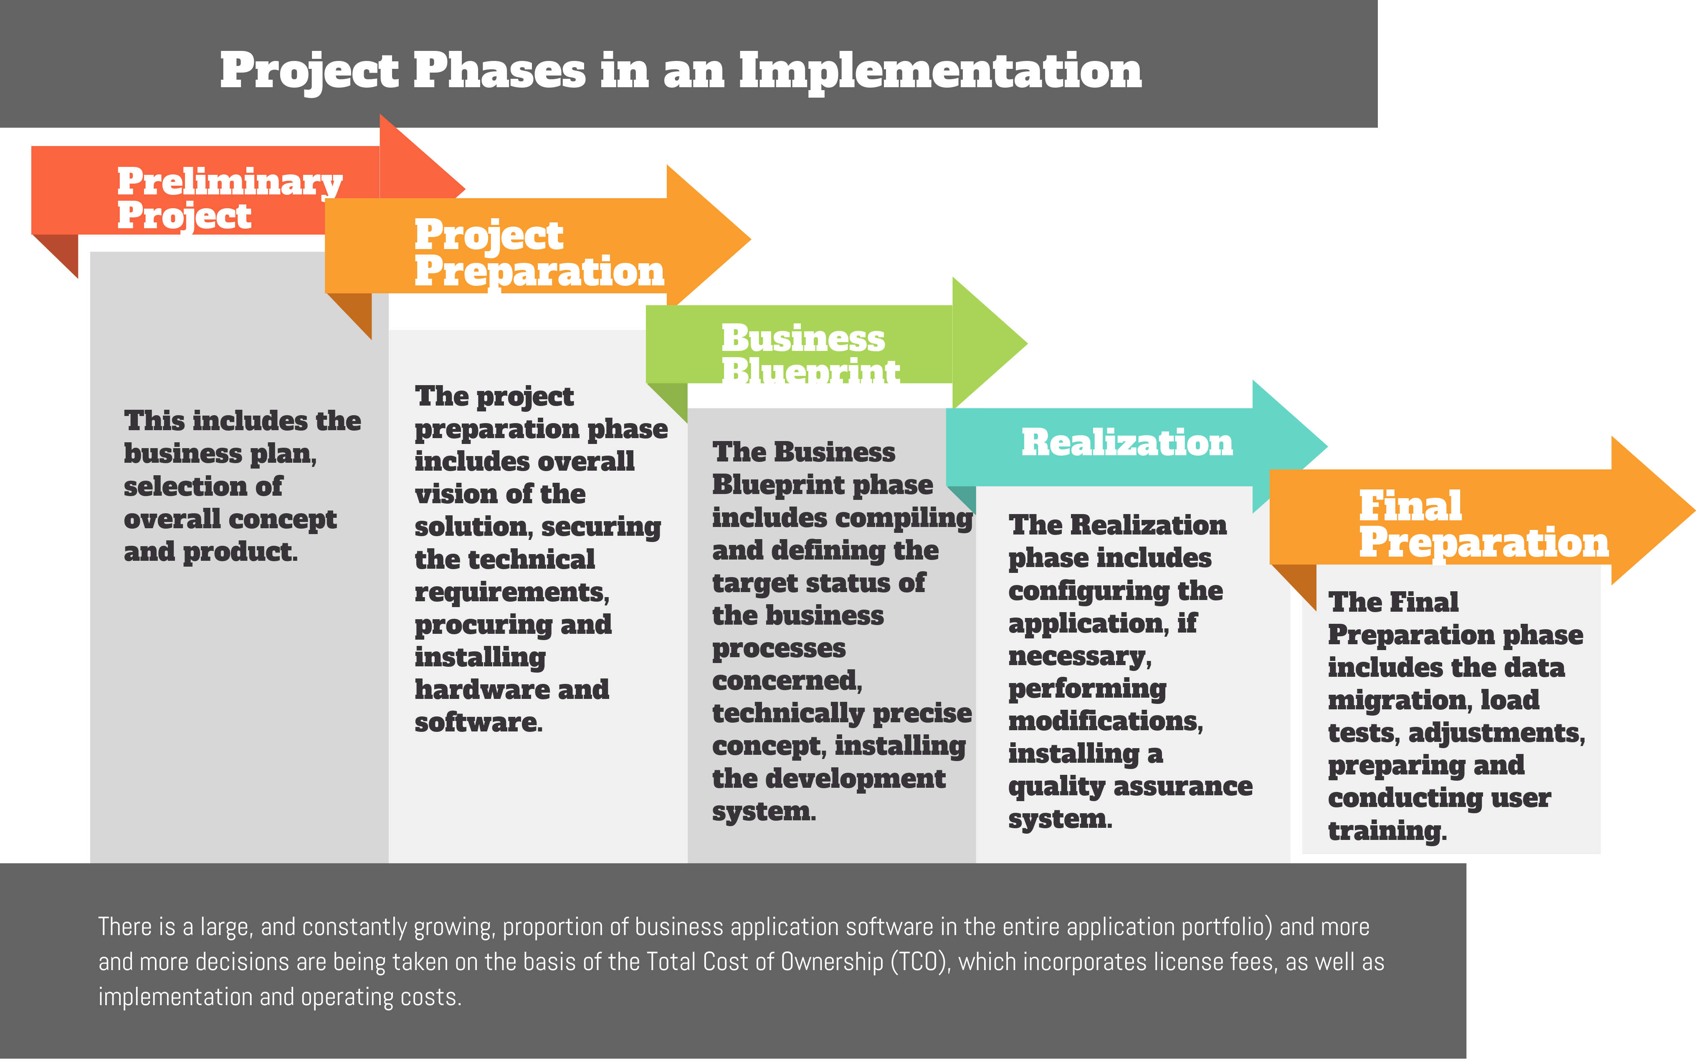
Implementation Steps
Conduct a thorough analysis of requirements and user needs.
Develop a detailed project plan outlining milestones and timelines.
Collaborate with stakeholders for feedback and testing to ensure system functionality.
Notes:
Image source: https://mungfali.com/explore/Project-Management-Phases-Diagram

Slide 10
Training and Support
Provide training sessions for administrators and students on system usage.
Offer technical support and troubleshooting assistance for any system-related issues.
Implement user feedback mechanisms to continuously improve system performance.
Notes:
Image source: https://globaledu.net.in/student-training

Slide 11
Conclusion
The online student result system offers a comprehensive solution for efficient data management and access.
By leveraging PHP and MySQL technologies, the system ensures scalability and reliability.
Continuous updates and enhancements will further optimize the system for the benefit of both administrators and students.
Notes:
Image source: http://resulthosting.net/online-result-management-system.html

